Slide 1
Disaster Relief: Group-Level Mobility Modeling
Using Geo-Tagged Social Media
Lu Cheng PhD, Computer Science
Jiayong Mo Master, Computer Science
Linzhen Luo Master, Computer Engineering
Bernard Ngabonziza PhD, Computer Science

Slide 2
BACKGROUND
Mobility modeling aims at understanding human movement regularity.
The recent prevalence of geo-tagged social media (GeoSM) brings new opportunities to this task:
In addition to spatial and temporal information, each GeoSM records (e.g., tweet, Facebook post) also has text.
The GeoSM data has a much larger size and a much better coverage of the population than GPS trace data.

Slide 3
GOALS
We aim to unveil human movement regularity during disaster response using large-scale GeoSM data.
Speciﬁcally, focus on following questions:
What are the intrinsic states underlying people’s movements?
How do people move sequentially between those latent states?

Slide 4
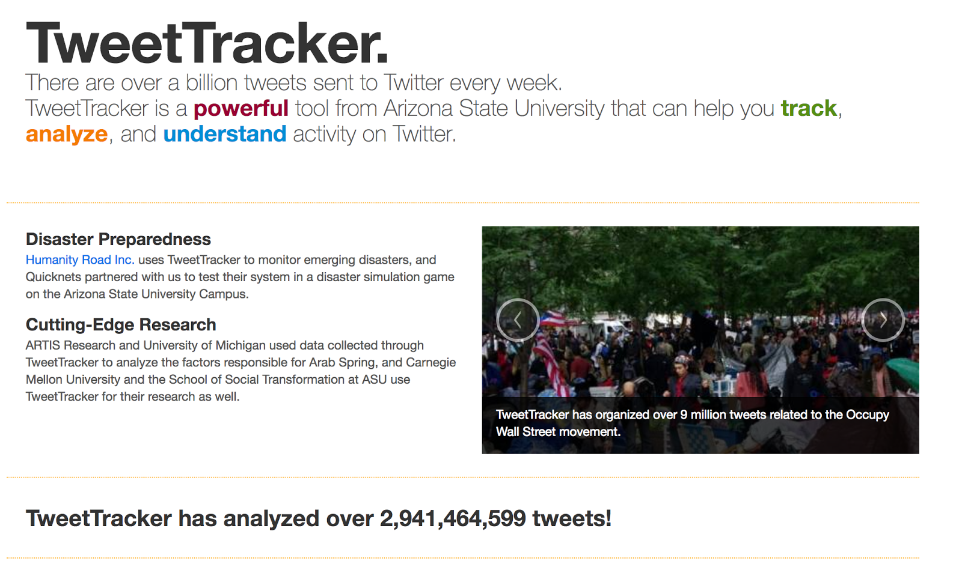
CHALLENGES & DATA CRAWLING
Dilemma for mobility modeling using GeoSM data:
GeoSM (e.g., tweets) have very short text, making it hard to model the semantics of human activities.

Slide 5



OUTLINES
• Data Collection & Exploration
• Machine Translation
• Human Mobility Model

Slide 6

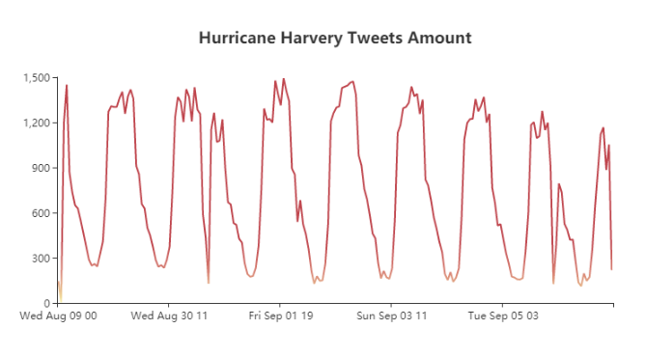
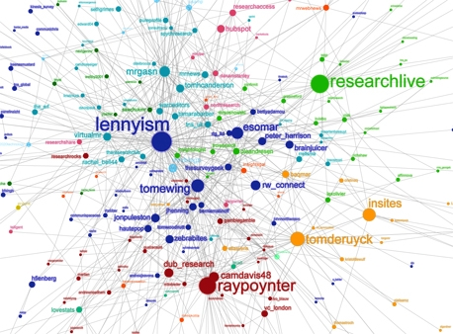
Social Network

HIGHLIGHTS
Then how do make it come true?
Friend prediction is based on text similarity and interaction frequency.
location is inferenced from friend’s geo-tagged tweets.
Features
Regression Decision Tree
Belief Propagation
Dynamic Bayesian Network
The tweet data distribution based on the time

Slide 7
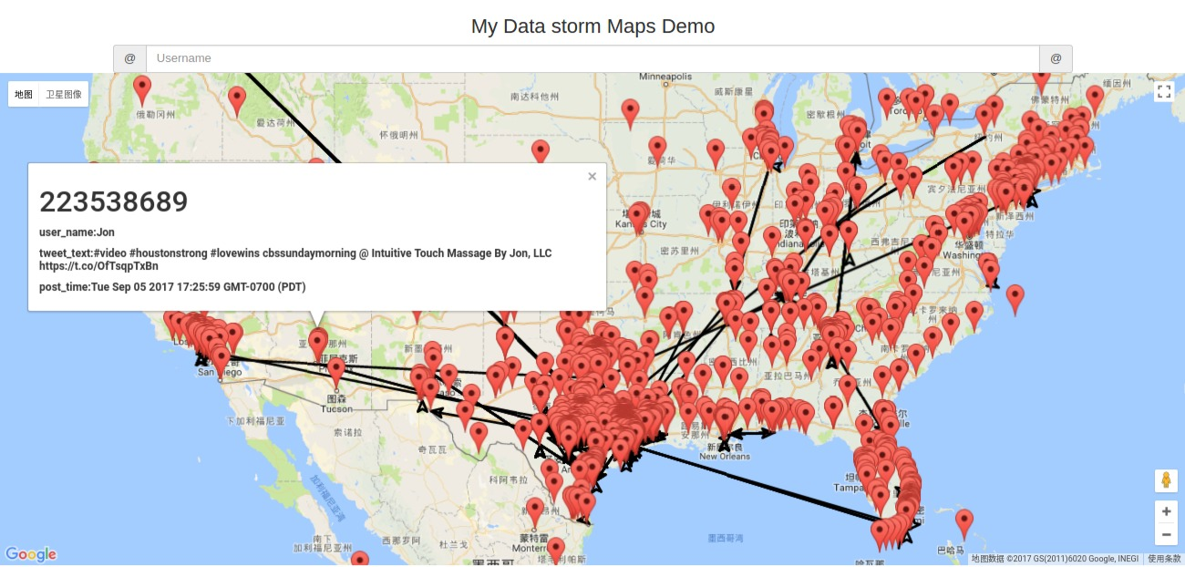
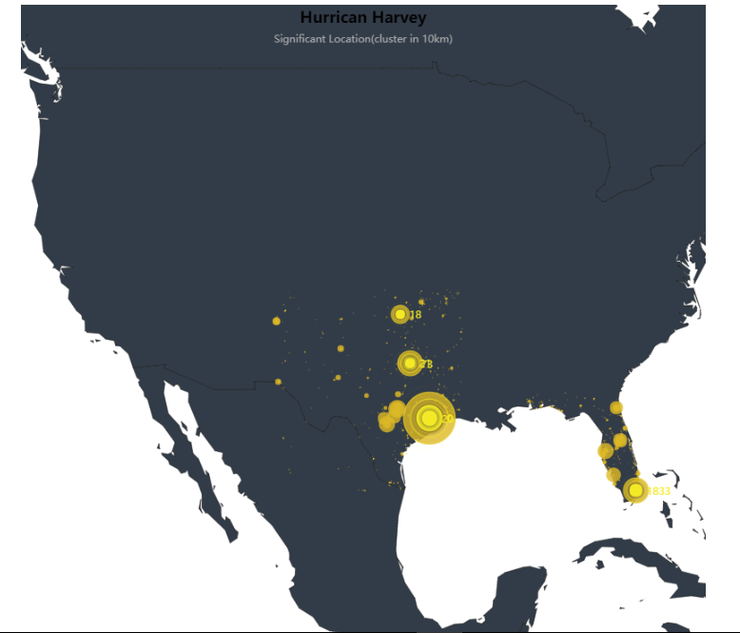
Location Estimation
Harvey Hurricane
Significant Location
Location Information Overview
The geo-tagged tweets shown in the map during the time of Harvey hurricane,
but what about those tweets without geo-tag?

Slide 8
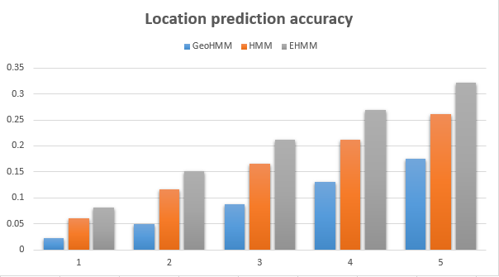
Prediction Method

Slide 9
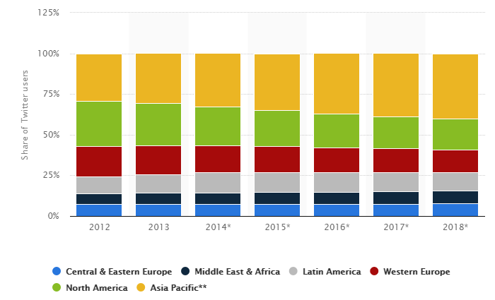
Machine Translation

Slide 10

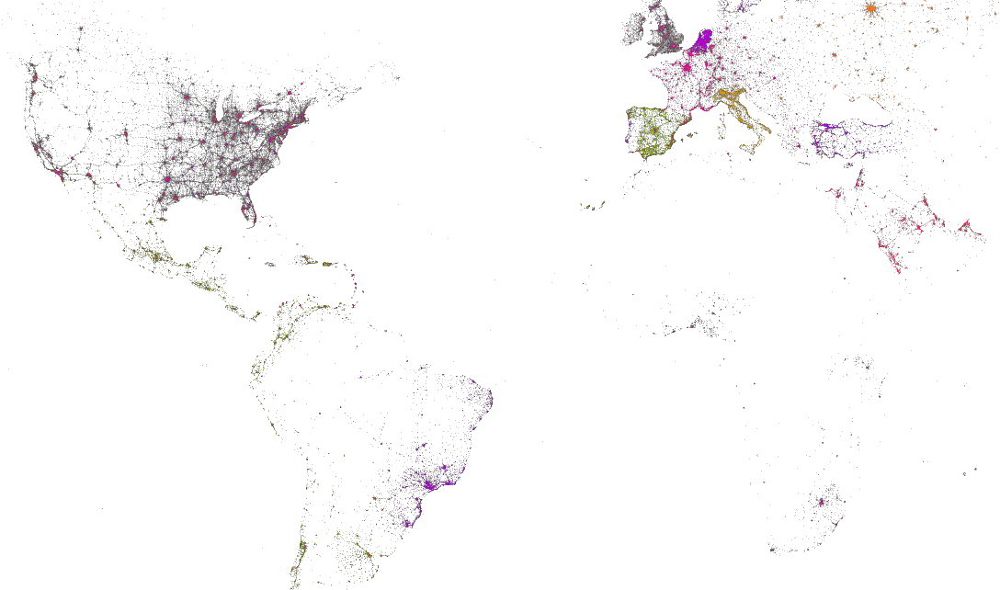
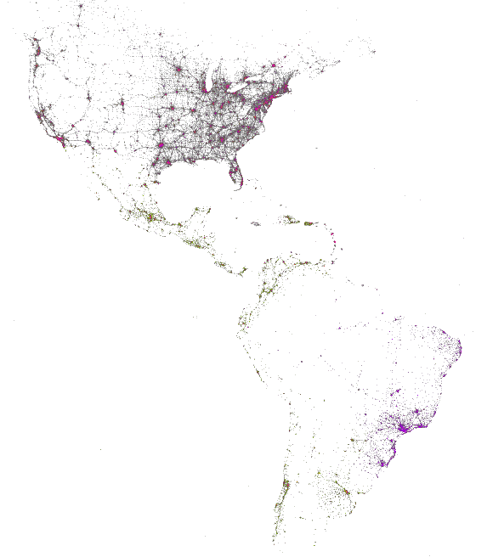
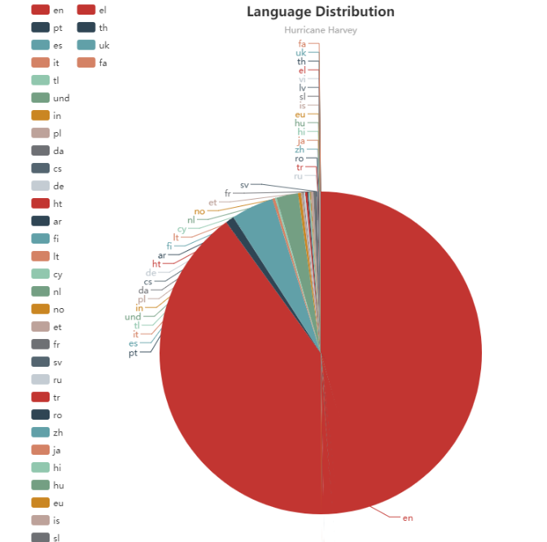
Languages On Twitters

Slide 11
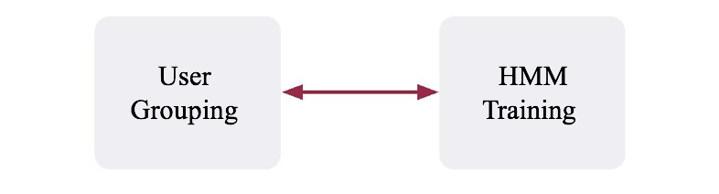
Human Mobility
An Iterative Process
GMove alternates between user grouping and HMM training.
HMM Training
User Grouping

Slide 12
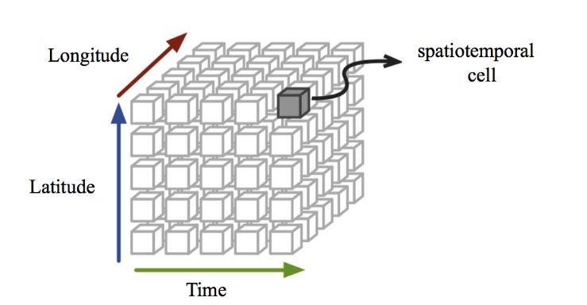
Text Augmentation
We discretize the space D into equal-size cells.
For each keyword k, we use its spatiotemporal distribution over the 3-D cube to obtain a vector V
Given two keywords, we compute their correlation as the cosine distance between their vectors.

Slide 13
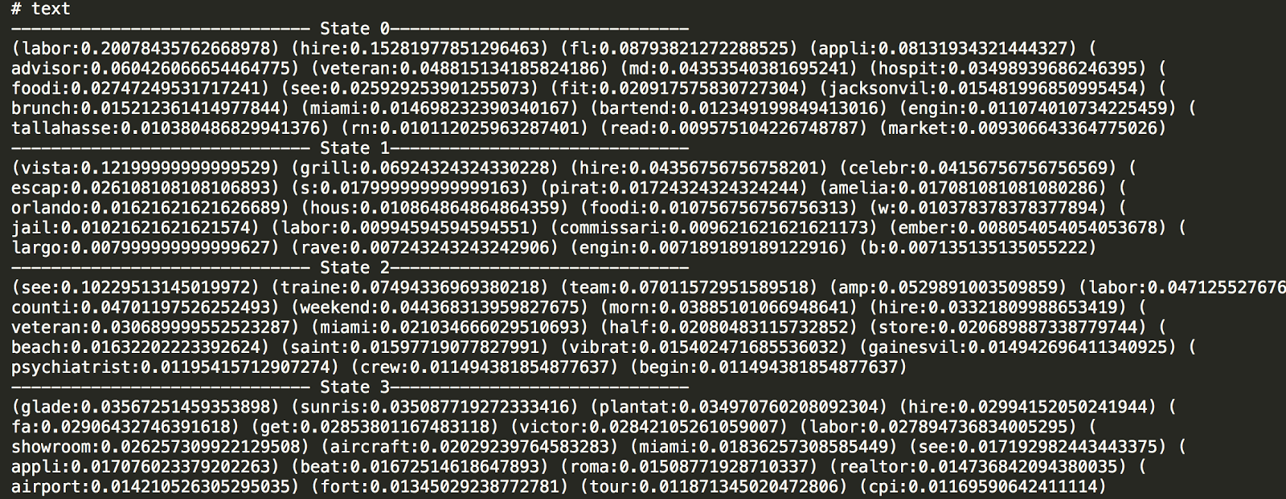
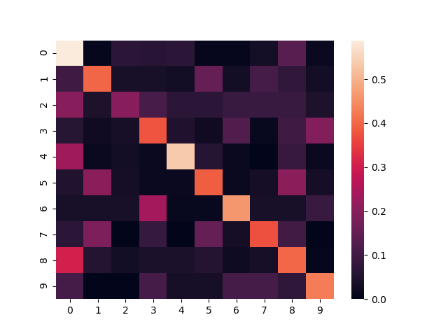
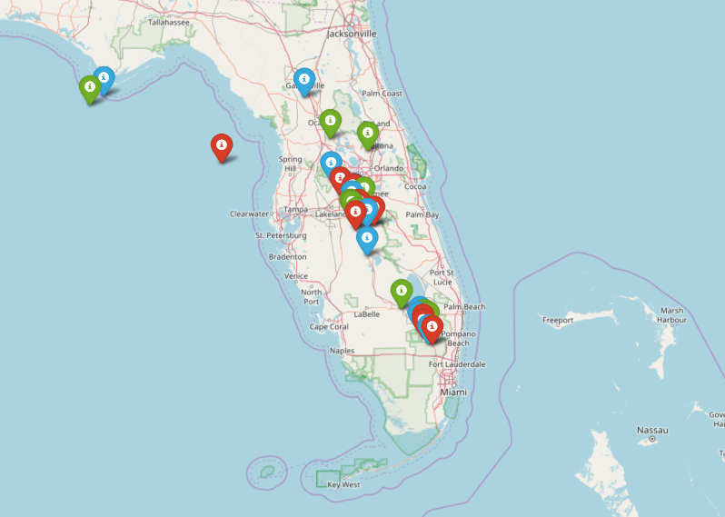
Outcome

Slide 14
Q&A

